Slide 1










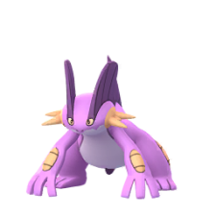
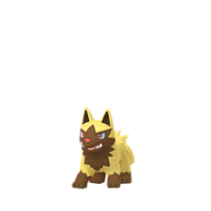
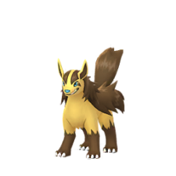

























Pokemon Go : Shiny Check List
Generation 3 ( Hoenn )
Treecko
Grovyle
Sceptile
Torchic
Combusken
Blaziken
MEGA On Page 6
MEGA On Page 6
Mudkip
Marshtomp
Swampert
Poochyena
Mightyena
Zigzagoon
MEGA On Page 6
Galarian On Page 5
Linoone
Wurmple
Silcoon
Beautifly
Cascoon
Dustox
Galarian On Page 5
Lotad
Lombre
Ludicolo
Seedot
Nuzleaf
Shiftry
Taillow
Swellow
Wingull
Pelipper
Ralts
Kirlia
Gardevoir
Surskit
Masquerain
Shroomish
Breloom
Slakoth
MEGA On Page 6
Page 1 of 6

Slide 2


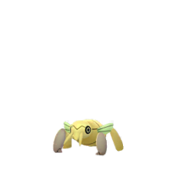













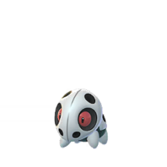

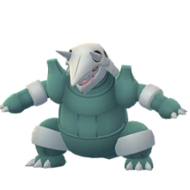

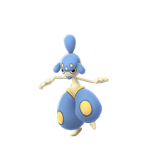
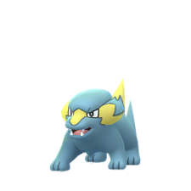
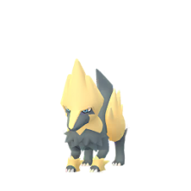












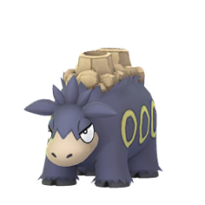
Pokemon Go : Shiny Check List
Generation 3 ( Hoenn )
Vigoroth
Slaking
Nincada
Ninjask
Shedinja
Whismur
Loudred
Exploud
Makuhita
Hariyama
Azurill
Nosepass
Skitty
Delcatty
Sableye
Mawile
Aron
Lairon
MEGA On Page 6
MEGA On Page 6
Aggron
Meditite
Medicham
Electrike
Manectric
Plusle
MEGA On Page 6
MEGA On Page 6
MEGA On Page 6
Minun
Volbeat
Illumise
Roselia
Gulpin
Swalot
Carvanha
Sharpedo
Wailmer
Wailord
Numel
Camerupt
MEGA On Page 6
MEGA On Page 6
Page 2 of 6

Slide 3











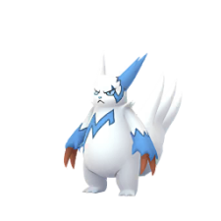



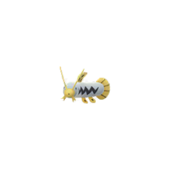





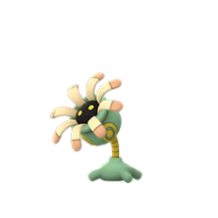






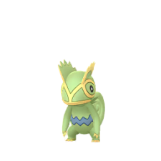







Pokemon Go : Shiny Check List
Generation 3 ( Hoenn )
Torkoal
Spoink
Grumpig
Spinda
Trapinch
Vibrava
More On Page 5
Flygon
Cacnea
Cacturne
Swablu
Altaria
Zangoose
MEGA On Page 6
Seviper
Lunatone
Solrock
Barboach
Whiscash
Corphish
Crawdaunt
Baltoy
Claydol
Lileep
Cradily
Anorith
Armaldo
Feebas
Milotic
Castform
Kecleon
Shuppet
More On Page 5
Banette
Duskull
Dusclops
Tropius
Chimecho
Absol
MEGA On Page 6
MEGA On Page 6
Page 3 of 6

Slide 4

















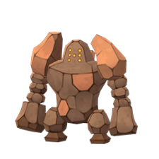


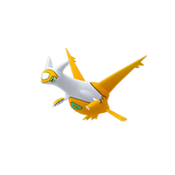


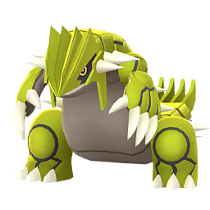
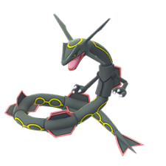

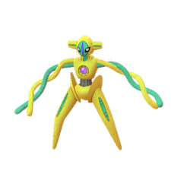
Pokemon Go : Shiny Check List
Generation 3 ( Hoenn )
Wynaut
Snorunt
Glalie
Spheal
Sealeo
Walrein
MEGA On Page 6
Clamperl
Huntail
Gorebyss
Relicanth
Luvdisc
Bagon
Shelgon
Salamence
Beldum
Metang
Metagross
Regirock
MEGA On Page 6
MEGA On Page 6
Regice
Registeel
Latias
Latios
Kyogre
Groudon
MEGA On Page 6
MEGA On Page 6
Primal On Page 6
Primal On Page 6
Rayquaza
Jirachi
Deoxys
MEGA On Page 6
More On Page 5
Page 4 of 6

Slide 5













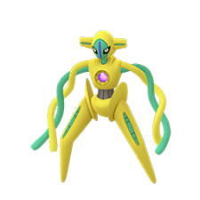
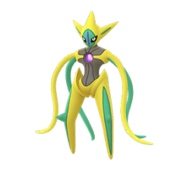

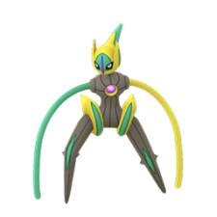
Pokemon Go : Shiny Check List
Generation 3 ( Hoenn )
Other’s and Galarian
Spinda
Pattern 1
Pattern 2
Pattern 3
Pattern 4
Pattern 5
Pattern 6
Pattern 7
Pattern 8
Heart
Galarian
Zigzagoon
Linoone
Castform
Normal
Sunny
Rainy
Snowy
Deoxys
Normal
Attack
Defence
Speed
Page 5 of 6

Slide 6

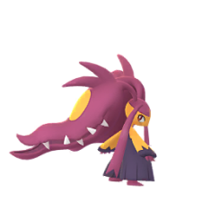
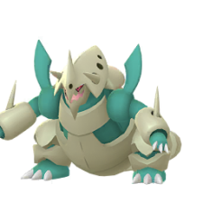
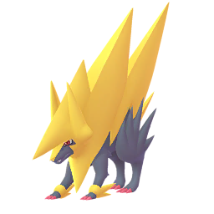
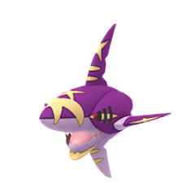
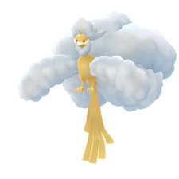
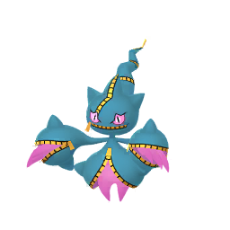



Pokemon Go : Shiny Check List
Generation 3 ( Hoenn )
MEGA & PRIMAL
MEGA
Sceptile
Blaziken
Swampert
Gardevoir
Sableye
Mawile
NO SPRITE
NO SPRITE
NO SPRITE
NO SPRITE
Aggron
Medicham
Manectric
Sharpedo
Camerupt
Altaria
NO SPRITE
NO SPRITE
Banette
Absol
Glalie
Salamence
Metagross
Latias
NO SPRITE
NO SPRITE
NO SPRITE
Latios
Rayquaza
NO SPRITE
Primal
Groudon
Kyogre
NO SPRITE
NO SPRITE
Page 6 of 6

